Slide 1
Pronunciation of –ed past tenses

Slide 2
The focus of this lesson is the correct pronunciation of past tense regular verbs.

Slide 3
English Verbs
English verbs can take two forms:
Regular Verbs
Irregular Verbs

Slide 4
Regular vs. Irregular Verbs
The past tense of a regular verb is formed by adding an –ed ending. For example:
Walk Walked
Roll Rolled
The past tense of irregular verbs is formed in many different ways. For example:
Go Went
Write Wrote
Put Put

Slide 5
Past tense of regular verbs is pronounced in 03 different ways:
/t/
/d/
/ɪd/

Slide 6
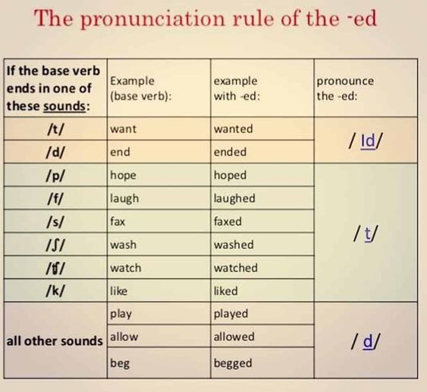

Slide 7
Here is a chart for the pronunciation of the –ed endings.
/t/ | /ɪd/ | /d/ | -
/p/ /k/ /tʃ/ /f/ /θ/ /s/ /ʃ/ | /t/ /d/ | Rest of the sounds | /r/ /j/ /h/ /w/
Voiceless sounds
These sounds, in British English, never occur in word-final position.
If we have any of these 7 sounds in word-final position, -ed is pronounced as /t/.
Sounds with vocal chord vibration are voiced and sounds without vocal chord vibration are voiceless.

Slide 8
Examples of Past Tense Pronunciation

Slide 9
Pronunciation of –ed /t/
Rush-----------------------------Rushed.
Look-----------------------------Looked.
Slap------------------------------Slapped.
Knock----------------------------Knocked.
Snatch---------------------------Snatched.
Discuss--------------------------Discussed.
Help------------------------------Helped.
Laugh----------------------------Laughed.

Slide 10
Pronunciation of –ed /d/
Arrive-----------------------------Arrived.
Enjoy------------------------------Enjoyed.
Call---------------------------------Called.
Pulled------------------------------Pulled.
Listen-------------------------------Listened.
Harm-------------------------------Harmed.
Consider---------------------------Considered.
Change-----------------------------Changed.

Slide 11
Pronunciation of –ed /ɪd/
Demand------------------------------Demanded.
Count---------------------------------Counted.
Recommend ------------------------Recommended.
Contact-------------------------------Contacted.
Invent---------------------------------Invented.
Scold----------------------------------Scolded.
Vote-----------------------------------Voted.

